Slide 1
PERSENTATION ON MALIGNANT PROJECT
SUBMITTED BY:-
HITESH KUMAR SHARMA

Slide 2
AGENDA
Introduction
Objective
Problem Definition
EDA Process
Pre – Processing Pipelines
Model Building
Conclusion

Slide 3
INTRODUCTION
The proliferation of social media enables people to express their opinions widely online. However, at the same time, this has resulted in the emergence of conflict and hate, making online environments uninviting for users. Although researchers have found that hate is a problem across multiple platforms, there is a lack of models for online hate detection.
Online hate, described as abusive language, aggression, cyber bullying, hatefulness and many others has been identified as a major threat on online social media platforms. Social media platforms are the most prominent grounds for such toxic behaviour.

Slide 4
There has been a remarkable increase in the cases of cyber bullying and trolls on various social media platforms. Many celebrities and influences are facing backlashes from people and have to come across hateful and offensive comments. This can take a toll on anyone and affect them mentally leading to depression, mental illness, self-hatred and suicidal thoughts.
Internet comments are bastions of hatred and vitriol. While online anonymity has provided a new outlet for aggression and hate speech, machine learning can be used to fight it. The problem we sought to solve was the tagging of internet comments that are aggressive towards other users. This means that insults to third parties such as celebrities will be tagged as unoffensive , but “u are an idiot” is clearly offensive.

Slide 5
OBJECTIVE
Firstly collect the both data train and test
Clean the review text data using all NLP pre – processing
Using basic attribute and methods
Using machine learning models
All text data to convert vector form using tfidfvectorizer
These models checking cross val score and choose the best model
Clean the review text data using different method
Using word cloud library and sentiment intensity analyzer for NLP task

Slide 6
PROBLEM DEFINITION
This data has classification problem for malignants column which has two class to identify for malignant 0 or 1 class data. It has only many column represent comment_text , malignants ,loath ,threat , abuse etc.
In this type classification problem to solve NLP(natural language processing) task and different methods and technique used for NLP task to solve and this data clean and process to easily readable and understandable.
More column and rows are used to this shape (312735,2) and In this data output column is malignants in this two class is present.
In this merge both train and test data and all preprocessing is done on this dataset.

Slide 7
Lets Move EDA Process
In this , I have used multiple methods , attributes so that we can understand the data well such as –
Check the dataset shape using shape attribute
Check the columns name use columns attribute
Check the datatypes using dtypes attribute
Check the all attribute count, datatypes, columns name using info() methods, value_counts() ,unique() ,rename() methods
Check the null value use isnull().sum() methods but this dataset no null value present.
Check the top row using head() and tail() method

Slide 8
NLP Task for Cleaning methods
In text data remove all punctuation marks
showing that in length column to counting no of character use in text data
Using regex substitute methods for removing email /web address , money symbols, phone number, any type of number, white spaces etc.
Remove all stopwords
Finally create length for identify clean data length observed.

Slide 9
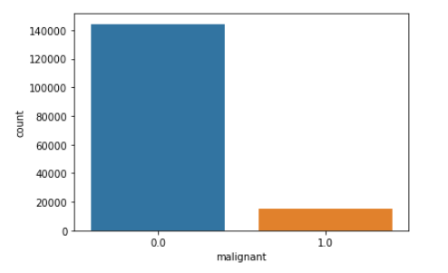
Univariate analysis

Slide 10
Pre – Processing Pipeline
Using word cloud technique for visualize the maximum number of words used in any textual content.
Using sentimental intensity analyzer for specially to sentiment expressed in social media.
Using TfIdfVectorizer technique for convert the collection of row documents to matrix of Tf – Idf features.

Slide 11
Model Building
Decision Tree Classifier
Logistic Regression
K – Neighbors Classifier

Slide 12
Model Accuracy Score
Model Score
Decision tree classifier - 94.58%
Logistic Regression - 95.62%
K – neighbors classifier - 89.11%

Slide 13
Model Cross Val Score
Model Score
Decision tree classifier - 94.37%
Logistic Regression - 95.43%
K – neighbors classifier - 89.81%

Slide 14
CONCLUSION
Now further to choose best model , I need to see of these models minimum difference accuracy score and cross val score and the model that will have the least difference , The same model would be best for this dataset.
Minimum difference is accuracy score and cross val score decision Tree classifier() model so this is our best model.
Then use best model predict the new test data for comment to predict the class malignant that use particular comments .

Slide 15
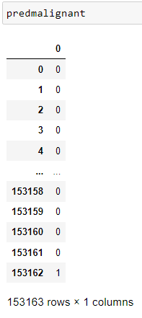


Predict the malignants

Slide 16
THANK
YOU ?

